Slide 1
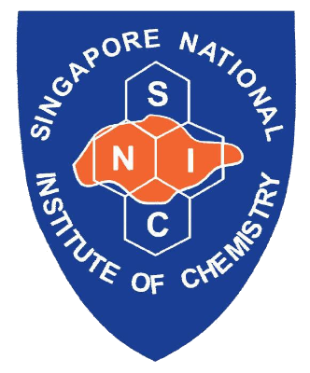
Singapore
National Institute
of
Chemistry
ACTIVITY REPORT
May 2025- Current

Slide 2
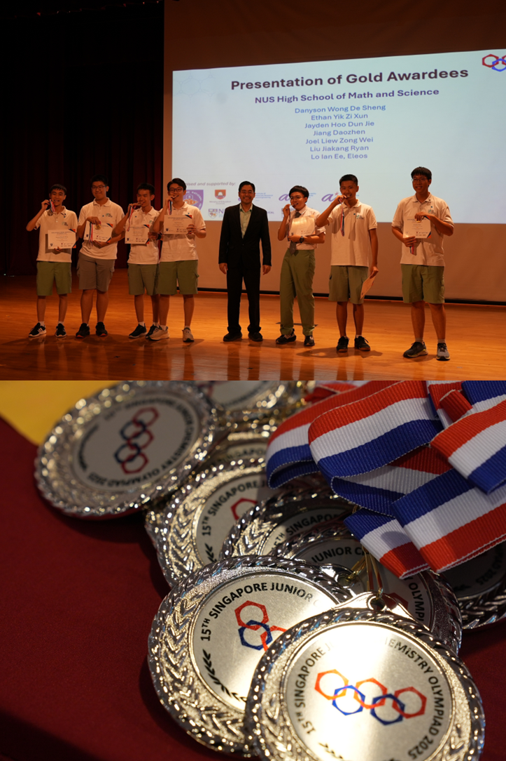
15th Singapore Junior Chemistry Olympiad (SJChO)
Round 1: | MCQ; 28 May 2025
Round 2: | Open-ended questions; 02 Jul 2025
Duration: | 2 hours
Format: | Virtually via Class Marker platform Physical Awards ceremony held on 14 Aug 2025
Total Attendance: | 133 Schools (ꜛ13%) and 3323 students (ꜛ6%)

Slide 3
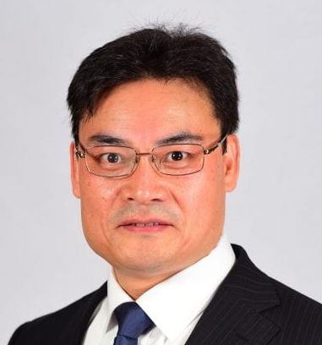
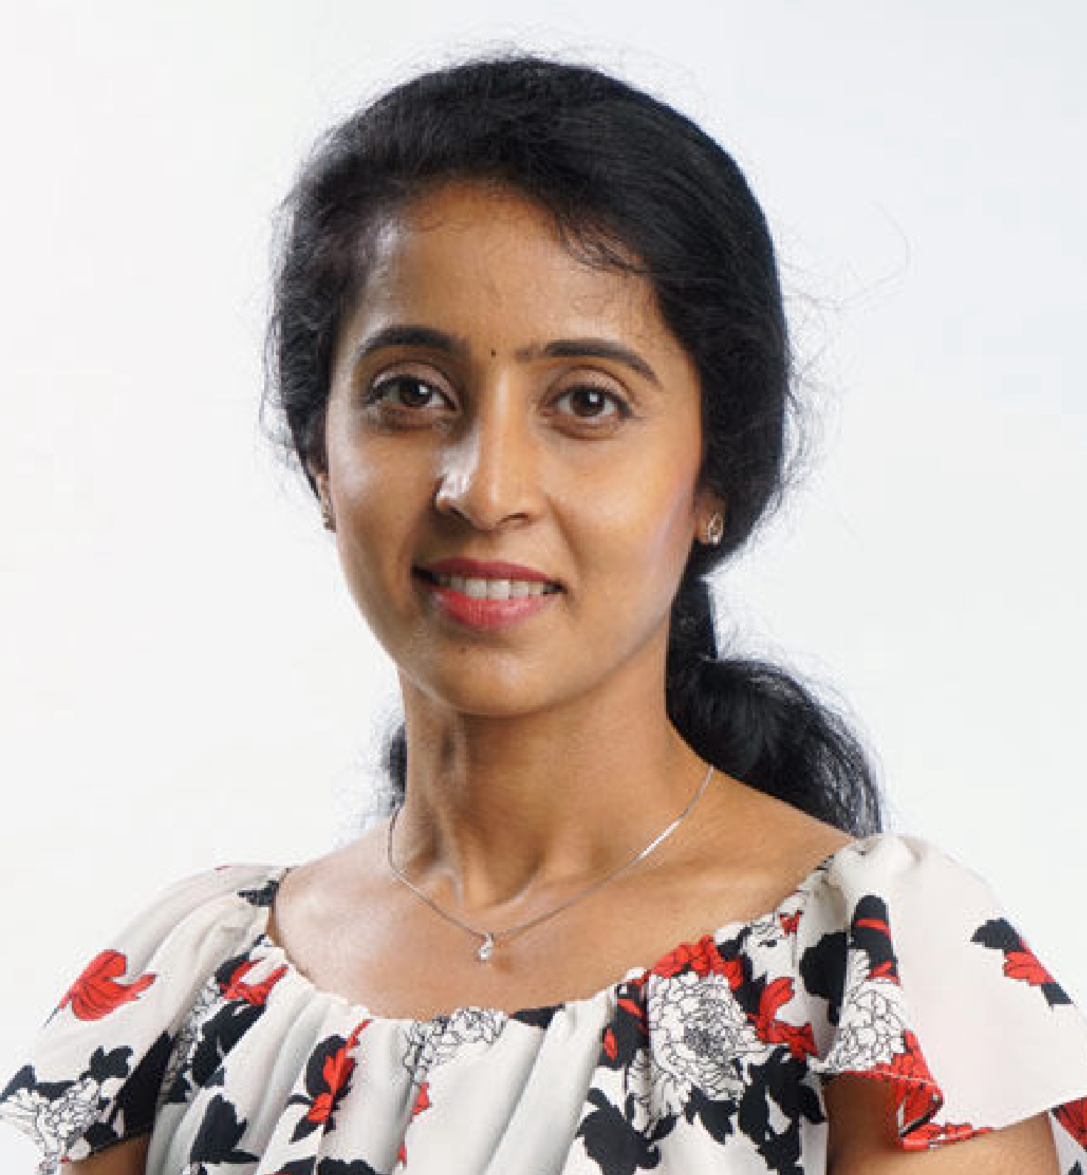
SNIC-AsCA 2019 Singapore Award for the year 2025
Solid-State Chemistry & Materials Award 2025
presented to:
Professor Donglin JIANG, NUS
Distinguished Woman Chemist Award 2025
presented to:
Professor Madhavi SRINIVASAN, NTU
Note: Asian Crystallographic Association (AsCA) was first held at the National Singapore (NUS) from 17-20 December 2019) # AsCA2019

Slide 4
Upcoming Event and Conference
16th Singapore Junior Chemistry Olympiad (SJChO 2026)
- Held on 20 May 2026 (Round 1) and 1 Jul 2026 (Round 2)
- Targeting over 3300 students
13th Singapore International Chemistry Conference (SICC-13)
- Held from 7-11 Dec 2026 at Suntec City Convention Centre
- Targeting over 1500 attendees

Slide 5
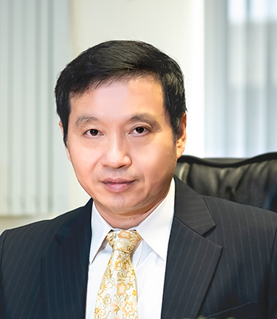
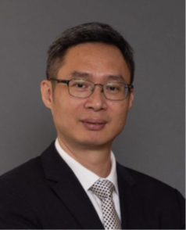
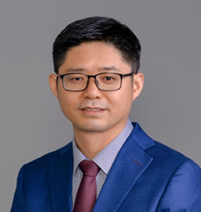
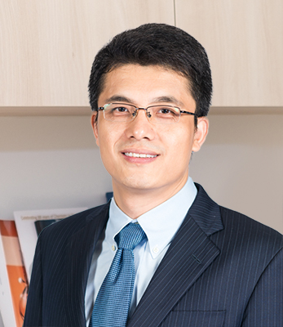
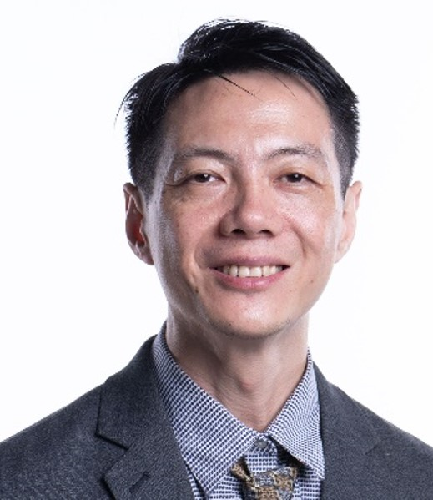
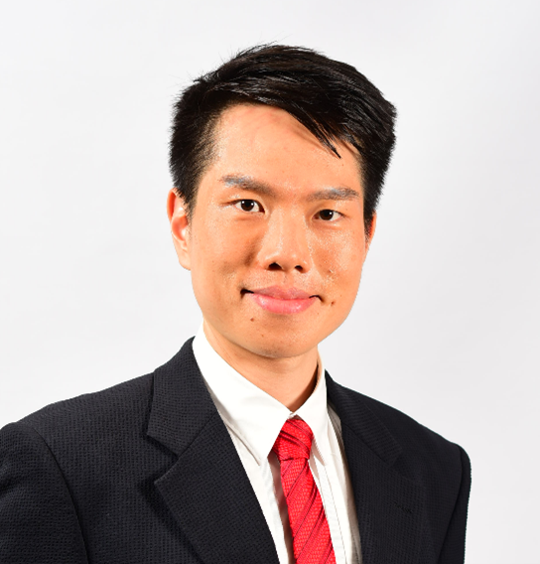
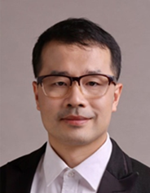
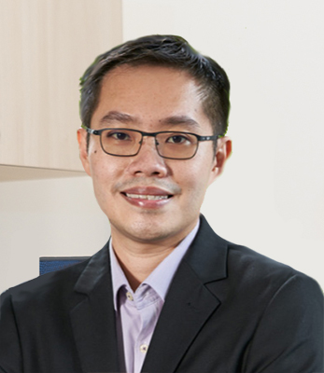
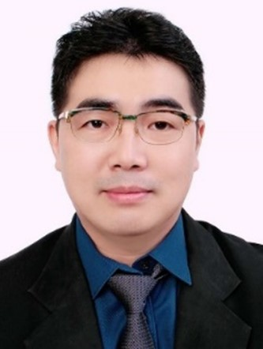
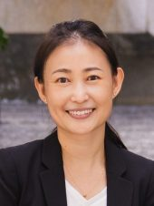
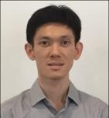
INTRODUCING Current Office Bearers
PRESIDENT
Prof Yixin LU
NUS
HON. SECRETARY
Prof Xiaodong CHEN
NTU
HON. TREASURER
Prof Jiong LU
NUS
HON. ASST SECRETARY
Prof Yu ZHAO
NUS
HON. ASST TREASURER
Prof Alex YAN
NTU
COUNCIL MEMBER
Dr Qiang ZHU
IMRE
COUNCIL MEMBER
Dr Fun Man FUNG
UCD
COUNCIL MEMBER
A/P Xiaogang LIU
NTU
COUNCIL MEMBER
A/P Ming Joo KOH
NUS
CO-OP COUNCIL MEMBER
A/P Han Sen SOO
NTU
CO-OP COUNCIL MEMBER
Dr Lili ZHANG
IMRE

